Slide 1

Analyze E-Commerce Sales to Improve Customer Conversion & Retention
NAME : BRINDHA.K
ENROLLMENT NUMBER :EN12025086071
BATCH CODE :DA764S76
COURSE :DATA SCIENCE AND ML WITH GEN AI ADVANCED PROGRAM

Slide 2

Project Overview:
This project presents an end-to-end analytical overhaul of an e-commerce platform operating across India. By integrating multi-table relational data across customer demographics, orders, logistics, and product catalogs, the project translates raw transactional data into actionable business intelligence. The pipeline spans data ingestion, exploratory data analysis (EDA), database development, statistical hypothesis testing, interactive dashboards, and machine learning feature selection.
Project Objective
Operational Optimization: Identify supply chain bottlenecks and eliminate Fulfillment Cycle Time breaches against established Service Level Agreements (SLAs).
Customer Retention & Segmentation: Uncover demographic drivers of Average Order Value (AOV) and target high-value age cohorts.
Commercial & Pricing Strategy: Assess discount elasticity, optimize pricing tiers, and isolate top-performing revenue brands.
Satisfaction Driver Mapping: Scientifically quantify key friction points (delays, payment channels) driving negative customer reviews.
Decision Support Architecture: Build interactive, executive-ready Excel and Power BI dashboards backed by scalable MySQL models.

Slide 3
Tools & Technologies:
Tool | Key Uses & Applications
Excel | Data cleaning, pivot tables, advanced formulas, IQR outlier detection, dashboards, segmentation, trend analysis
SQL | Data integration, multi‑table JOINs, filtering, aggregation (SUM, AVG, COUNT), stored procedures, business queries
Python | Data cleaning (Pandas, NumPy), exploratory data analysis (EDA), visualization (Matplotlib, Seaborn), correlation & statistical analysis
Power BI | Interactive dashboards, KPIs, trend analysis, star schema modeling, DAX measures, Key Influencers, decomposition trees

Slide 4
Datasets: Records, Purpose, Key Fields & Relationships
Table Name | Total Records | Key Fields | Purpose | Key Relational Keys
Customers_dataset | 90,000 | Demographics, Zip Code, Age Group, Loyalty Segment | Capture customer identity, age cohorts, and loyalty distribution | customer_id $\rightarrow$ Orders
Geolocation_dataset | 155,545 | Indian State/City mappings, Postal Codes, GPS Coordinates | Map geographic footprint and spatial logistics performance | customer_zip_code $\rightarrow$ Customers
Products_dataset | 32,951 | Category, Sub-category, Brand, Weight, Cost Price, Selling Price | Portfolio performance, margin analysis, and inventory weight | product_id $\rightarrow$ Order Items
Orders_dataset | 99,999 | Order Statuses, Payment Types, Tracking Timestamps | Operational order progression, delivery timelines, and statuses | order_id $\rightarrow$ Order Items, Reviews
Order_items_dataset | 150,000 | Quantities, Unit Prices, Discounts, Shipping Fees | Detailed transactional granular breakdown and item economics | Primary transaction table linking Orders & Products
Order_reviews_dataset | 97,019 | Review Ratings (1–5 scale), Text Comments, Timestamps | Monitor customer sentiment and feedback correlation | order_id $\rightarrow$ Orders

Slide 5

EDA-Exploratory Data Analysis
1.DATA UPLOAD
2. Data Understanding / Inspection
You performed:
Duplicate Removal You removed duplicate records from: “Duplicate records were identified and removed from all six datasets to improve data quality and prevent duplicate records from affecting the analysis.”
Missing-Value Treatment You checked missing values in all datasets. You handled missing values by: Removing incomplete order records based on required date fields. Forward fill (ffill) and backward fill (bfill) for selected review and geographic fields. Checking the dataset again after treatment.
Date-Time Processing You identified order-related date columns and converted relevant columns to datetime format. You used dates for calculating: ✓ Order month ✓ Fulfillment time ✓ Delivery delay
head() – viewed sample records
info() – checked columns and data typs
describe() – examined numerical statistics
shape – checked rows and columns
columns – identified available fields
dtypes – checked data types
isnull().sum() – checked missing values

Slide 6
Outlier Analysis:
Dataset Merging:
Statistical Analysis
You performed IQR-based outlier detection. You checked:
Product weight
Cost price
Selling price
Quantity
Unit price
Discount percentage
Shipping cost
You integrated the datasets using common keys. Main relationships included
You also performed statistical analysis.
Correlation Analysis:
Order Items + Products Key: product_id
Order Items + Orders Key: order_id
Orders + Customers Key: customer_id
Orders + Reviews Key: order_id
Customers + Geolocation Key: customer_zip_code
Discount % and Unit Price
Delivery Delay and Review Score
Central Tendency:You calculated: Measures of Dispersion
This created an integrated e-commerce dataset for analysis.
Mean
Median
Mode
You calculated:
Feature Engineering : You created/used calculated fields such as:
Q1
You calculated:
Q3
net_revenue
discount_tier
total_shipping_cost
fulfillment_days
delivery_delay_days
is_extreme_delay
Order month
IQR
Minimum
Maximum
Range
Variance
Standard deviation
Distribution
Skewness
Lower bound
Upper bound
You calculated:
This was applied to numerical variables such as:
Selling price
Cost price
Quantity

Slide 7
Data Visualization
You created different visualizations using Matplotlib and Seaborn, including:
Bar charts
Horizontal bar charts
Pie charts
Histograms
Line charts
Distribution plots
These visualizations were used to make the business patterns easier to understand.
Automated EDA
Your notebook also includes Sweetviz for automated exploratory data analysis.
You can explain:
“Sweetviz was used to automatically generate an exploratory data analysis report containing statistical summaries, distributions, missing-value information, and relationships between variables.”
Interactive Dashboard
You also created a Streamlit E-Commerce Analytics Dashboard.
Data Cleaning
Duplicate Removal Missing Value Treatment Date-Time Conversion Outlier Detection Data Integration / Merging | Feature Engineering Exploratory Data Analysis Business Questions and Analysis Data Visualization Statistical Analysis | Central TendencyDispersion Correlation Skewness Automated EDA using Sweetviz Streamlit Dashboard

Slide 8
Data Visualization
You created different visualizations using Matplotlib and Seaborn, including:
Bar charts
Horizontal bar charts
Pie charts
Histograms
Line charts
Distribution plots
These visualizations were used to make the business patterns easier to understand.
Interactive Dashboard
You also created a Streamlit E-Commerce Analytics Dashboard.
Data Cleaning
Duplicate Removal
Missing Value Treatment
Date-Time Conversion
Outlier Detection
Data Integration / Merging
Feature Engineering
Exploratory Data Analysis
Business Questions and Analysis
Data Visualization
Statistical Analysis
Central Tendency
Dispersion
Correlation
Skewness
Automated EDA using Sweetviz
Streamlit Dashboard

Slide 9
EXCEL ANALYSIS :
Core Excel Functions & Features You Used
CHARTS
Advanced Statistical & Outlier Analysis
Charts → used multiple chart types:
Clustered Column, Donut, Combo (Column + Line), Scatter Plot, Line Chart with Trendline, KPI Cards, Box Plot.
Statistical Measures → applied:
Average (AOV, review scores, fulfillment days)
Count (customer_id, order_id, review_id)
Sum (revenue, quantity, shipping cost)
% Difference From Previous Month (growth trends)
Outlier Detection (IQR method) → checked anomalies in unit price, discounts, shipping cost, and product weight.
Central Tendency & Dispersion
Pivot Tables → for summarizing data (Sum, Count, Average, % of Total, % Difference from Previous Month).
Value Field Settings → applied Sum, Count, Average, and Show Values As % of Grand Total.
Grouping → grouped age ranges, discount percentages, months, and product weights into bins.
Filters → applied filters (e.g., customer segment = Loyal, review_score IN (1,5), Top 10 by revenue).
Calculated Columns → created new fields like:
Fulfillment Days = order_delivered_customer_date – order_purchase_timestamp
Delay Days = order_delivered_customer_date – order_estimated_delivery_date
Applied IQR method to detect anomalies in unit price, discounts, shipping cost, and product weight.
Explored central tendency (mean, median, mode) for pricing and basket size behavior.
Examined dispersion & skewness → showed revenue risk from right‑skewed high‑value transactions.
Assessed gross profit margin variability → highlighted consistency issues across products.
In short: You demonstrated skills in pivot tables, chart building, segmentation, discount elasticity, fulfillment cycle analysis, anomaly detection, and statistical measures. Each domain connects Excel techniques to business insights

Slide 10
📊 Domain 1: Customer Analytics & Segmentation
💰 Domain 2: Sales, Pricing & Revenue Optimization
🚚 Domain 3: Supply Chain & Logistics
Built pivot tables to analyze revenue and AOV across gender and age groups → found 36–45 female cohort as top revenue generator.
Used donut chart to show customer distribution across loyalty tiers → “New” customers formed 50.2% of the base.
Filtered loyal customers and compared age segments → created combo chart showing count vs. average spend.
Audited missing ZIP codes → identified incomplete records affecting regional sales tracking.
Grouped discounts into ranges → discovered 1–20% discount range drives maximum order volume.
Ranked top 10 brands by revenue → Generic Indian & Global brands lead, followed by Urban Ladder.
Compared stock availability vs. sales → showed correlation between inventory and performance.
Tracked month‑over‑month revenue growth → identified seasonal demand spikes with trendline analysis.
Calculated fulfillment cycle time → average delivery took 72.27 days.
Analyzed freight charges vs. weight → found very low correlation (flat‑rate shipping).
Measured state‑wise delivery delays → Dadra & Nagar Haveli, Nagaland, Chandigarh had longest delays.
Checked order cancellation/unfulfilled rate → visualized with pie chart.
⭐ Domain 4: Customer Satisfaction & Reviews
ü Linked delivery delays to low ratings → delays strongly drive 1‑ and 2‑star reviews.
ü Compared payment methods vs. satisfaction → UPI (4.10) and Credit Card (4.09) scored highest.
ü Studied 1‑star vs. 5‑star reviews → severe delays correlated with poor ratings.

Slide 11
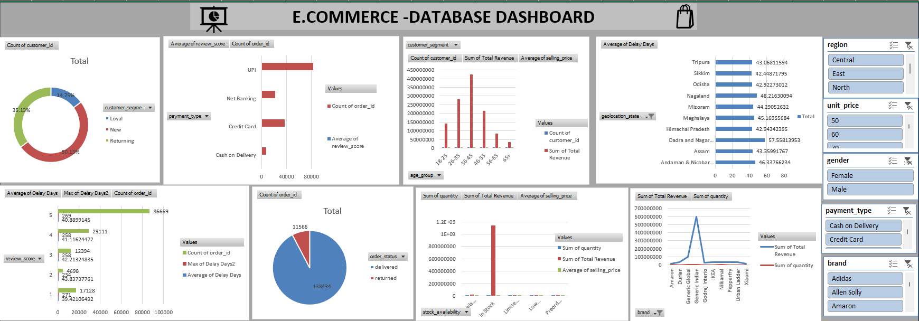

Slide 12
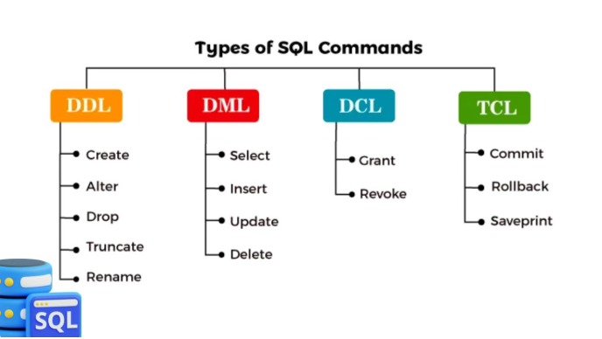


SQL ANALYSIS
SQL Concepts Used:
SELECT – Retrieve data.
WHERE – Filter records.
JOIN – Combine tables.
GROUP BY – Group records.
ORDER BY – Sort results.
LIMIT – Restrict number of rows.
SUM() – Total revenue.
AVG() – Average values.
COUNT() – Count records.
ROUND() – Round decimal values.
CASE – Create categories.
Subquery – Query inside another query
Stored Procedure – Reusable SQL program.
Main Business Analysis
Revenue and average order value by gender and age group.
Customer distribution by loyalty segment.
Loyal customer spending by age group.
Missing ZIP code audit.
Discount tier and revenue analysis.
Top 10 brands by revenue.
Stock availability and sales.
Monthly revenue trends.
Average delivery fulfillment time.
Shipping cost versus product weight.
Delivery delays by state.
Order status distribution.
Delivery delays and low ratings.
Customer satisfaction by payment type.
Comparison of 1-star and 5-star reviews.
Advanced SQL
Stored Procedure: Monthly revenue by year.
Correlation: Discount vs. selling price; delivery delay vs. review score.
Central Tendency: Mean, median, mode.
Dispersion: Range, variance, standard deviation
Important Formulas
Revenue = Quantity × Selling Price

Slide 13


Key SQL
. Project Outcome
Multiple table JOINs.
Aggregate functions.
Filtering with WHERE.
Grouping with GROUP BY.
Sorting with ORDER BY.
Subqueries for percentages.
CTEs for organized analysis.
Stored procedures for reusable reports.
Analyzed customer purchasing patterns.
Compared product and brand revenue.
Studied discount performance.
Investigated delivery delays.
Examined customer review scores.
Analyzed shipping costs.

Slide 14
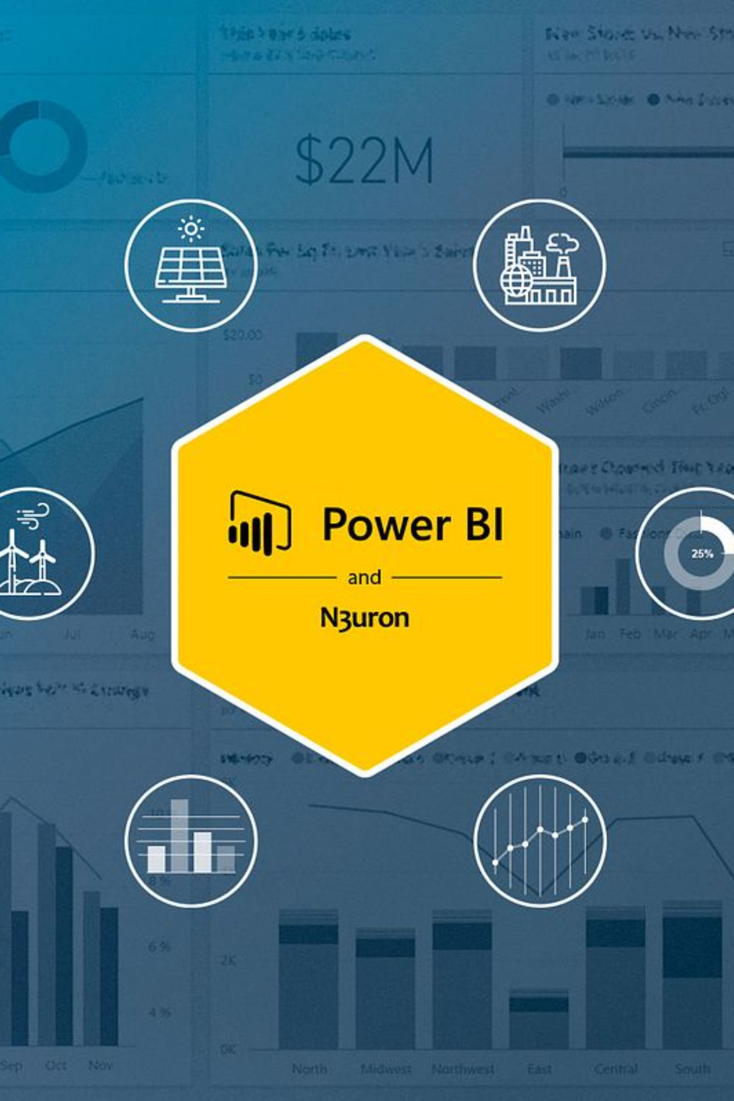
Power BI :
Created different charts for individual business questions, including column charts, bar charts, donut charts, maps, pie charts, and area charts.
Executive & Customer Demographics
A dashboard page focused on customer demographic and executive-level analysis.
Product & Commercial Elasticity
Visual analysis related to product performance and commercial or discount patterns.
Supply Chain & Logistics Operations
Charts and map visuals for logistics and supply chain analysis.
Customer Satisfaction & Ratings Impact
Visual analysis of customer satisfaction and review ratings.
Key Influencers:
Includes a Key Influencers visual and decomposition tree for exploring factors and breakdowns.
Dashboard
A dedicated dashboard page with action buttons and report navigation elements.

Slide 15
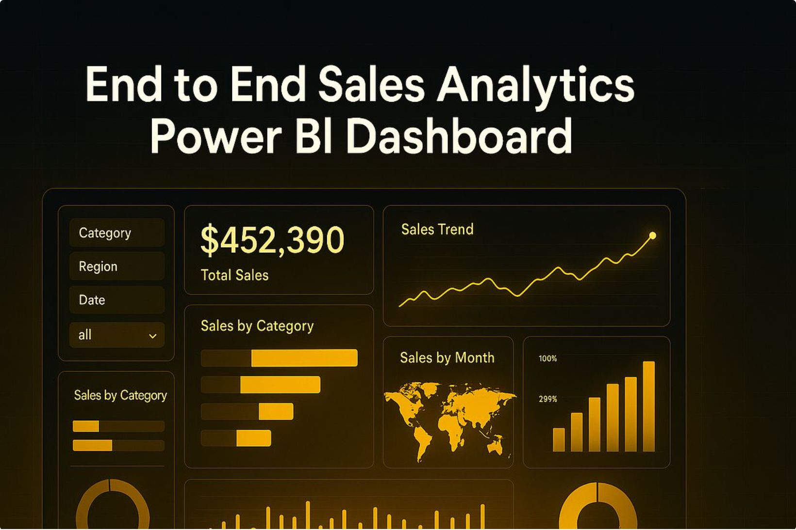
Final:
Data: Retail sales, customer, product, and logistics information.
Visuals: Bar, column, pie, donut, area, map, and other visuals.
Dashboards: Executive, product, logistics, and customer satisfaction pages.
Advanced Analysis: Key Influencers and decomposition tree.
Outcome: Presenting retail data in visual reports to understand business performance.

Slide 16
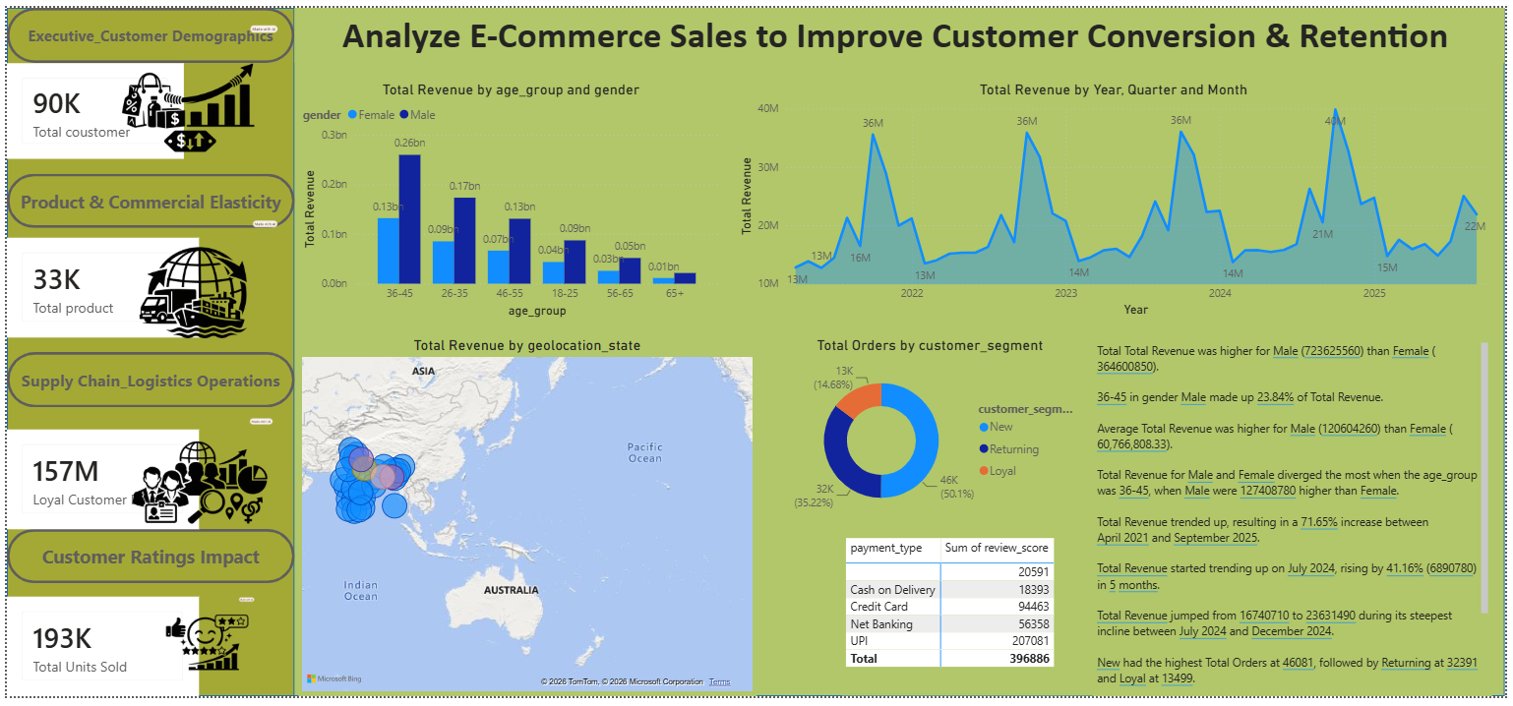

Slide 17




Hypothesis:
Main tests used:
Important Finding
Another Finding
Regression / ML
T-test → compare means
Z-test → compare large-sample means/proportions
Chi-square test → check relationship between categorical variables
“Payment channel and review score showed a statistically significant relationship, with p-value = 0.000783.”
“I predicted net revenue using product weight, shipping cost, quantity, customer segment, age group, discount tier, brand group and payment type.”
Models used:
Linear Regression
“Discount tiers had a statistically significant relationship with purchase quantity, with p-value < 0.001, so I rejected the null hypothesis.”

Slide 18
4. Data Preprocessing for ML
Model Evaluation
Numerical features → StandardScaler
Categorical features → OneHotEncoder
Data split → 70% train, 15% validation, 15% test
“I evaluated the models using:
R²
RMSE
MAE”
Conclusion:
This project demonstrates a full-stack analytics pipeline — from raw data cleaning and SQL queries to Excel pivot insights, Power BI dashboards, and machine learning models. The findings highlight discount elasticity, fulfillment delays, and demographic segmentation as the most critical levers for improving customer conversion and retention.

